Slide 1
Gas Turbine Emission
Analysis and modelling of 5 years’ data on Co and NOx gas emissions from gas turbines in a power generation plant.
Mentor:
Dr. Sayantani Roy Choudhury
Group Members:
Aditya Jaiswal – A22003
Chinmaya Venkataraman – A22014

Slide 2

Research Question
It is well known that CO and NOx gases are greenhouses gases that are produced in the power generation process and are harmful to the environment.
Minimisation of emissions is a pressing industry problem and there are regulations with regard to how much can be generated by a power plant.
We will attempt to predict the most important factors contributing to emissions and provide actionable steps to mitigate them.

Slide 3
Research Objective
Analysing 5 years’ data ( recorded from 2011 to 2015) on CO and NOx gas emissions from gas turbines in a power generation plant located in Turkey.
Identifying the most important features in the dataset.
Performing operations on the data and fitting Linear Regression models.
Training Machine Learning models on the data and comparing results to identify the best model using RMSE score.

Slide 4

Data Source
UC Irvine Machine Learning Repository, Gas Turbine CO and NOx Emission Data Set
Files: gt_2011.csv, gt_2012.csv, gt_2013.csv, gt_2014.csv, gt_2015.csv
Link: https://archive.ics.uci.edu/ml/machine-learning-databases/00551/pp_gas_emission.zip

Slide 5
Variables:
Variable
Abbreviation
Ambient temperature
Ambient pressure
Ambient humidity
Air filter difference pressure
Gas turbine exhaust pressure
Turbine inlet temperature
Turbine after temperature
Compressor discharge pressure
Turbine energy yield
Carbon monoxide
Nitrogen oxides
AT
AP
AH
AFDP
GTEP
TIT
TAT
CDP
TEY
CO
NOx

Slide 6
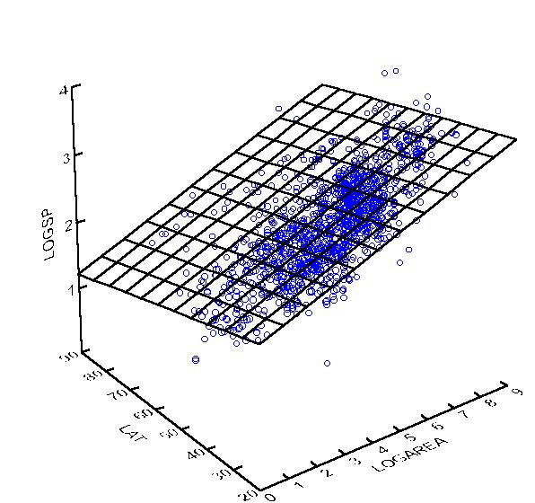
Methodology 1: Linear Regression
Measures Taken
Outlier Treatment using LOF (Local Outlier Factor)
Checking for and removing variables that have Variance Inflation factor higher than 5.
Feature Selection using Lasso Regression.

Slide 7
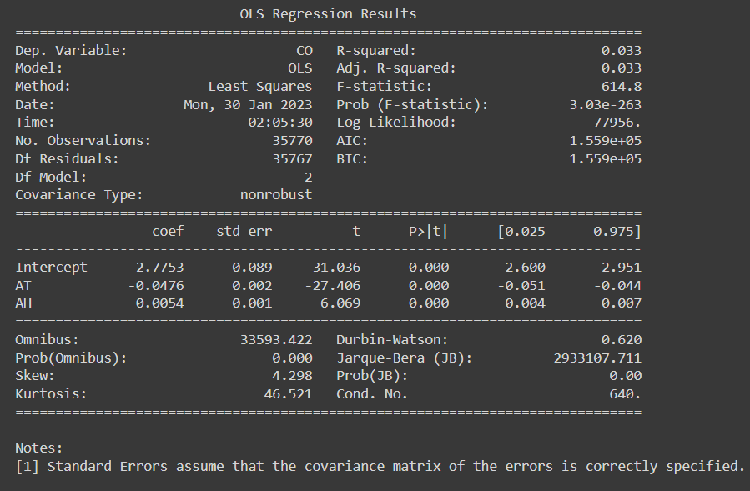
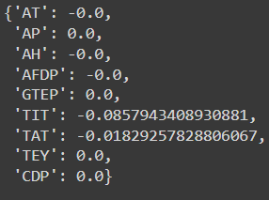
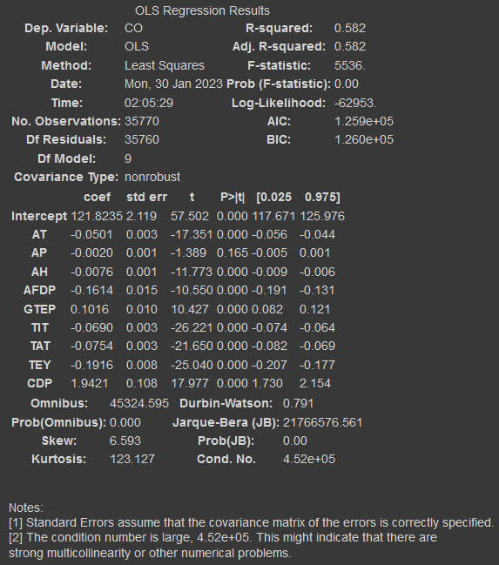
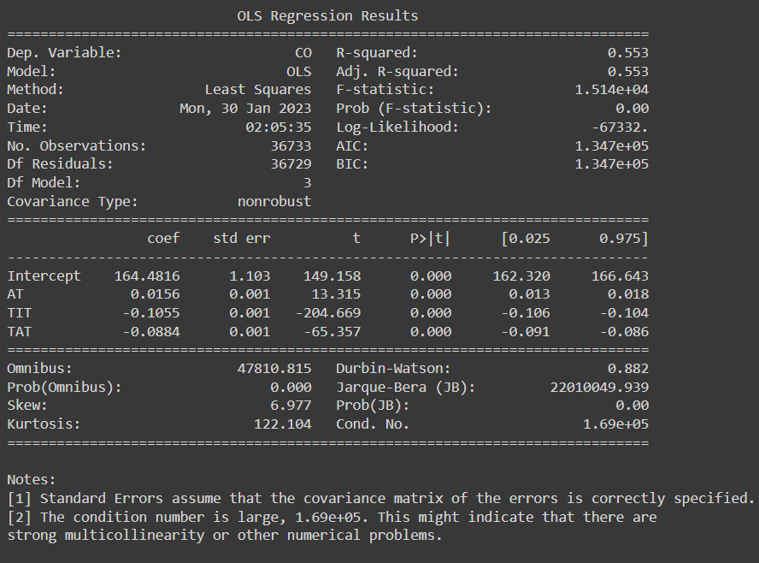
Results: CO
Lasso Regression coefficients:
Regression with all variables:
Regression with select variables:
AH
AT
AH
AT
AP
TIT
TAT
TEY

Slide 8
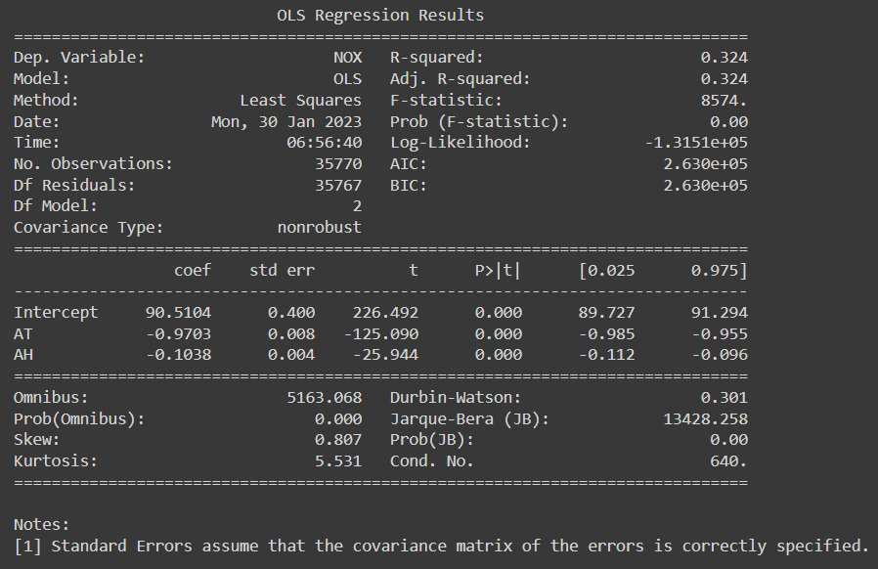
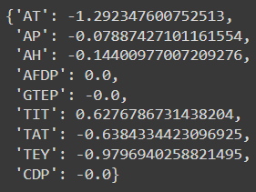
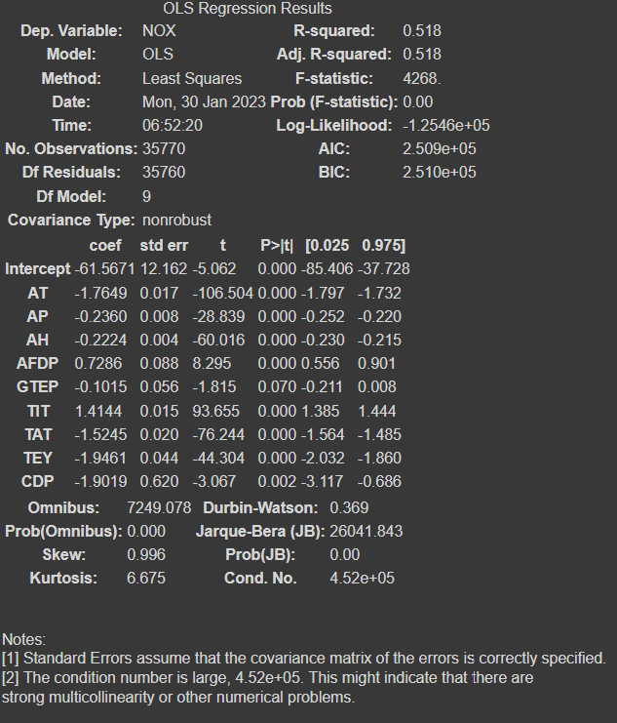
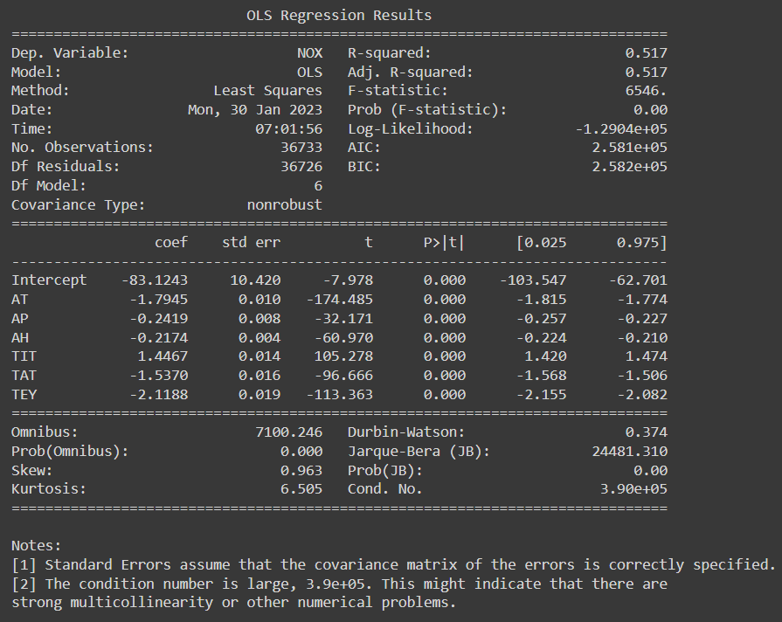
Results: NOx
Lasso Regression coefficients:
Regression with all variables:
Regression with select variables:
AH
AT
AH
AT
AP
TIT
TAT
TEY

Slide 9
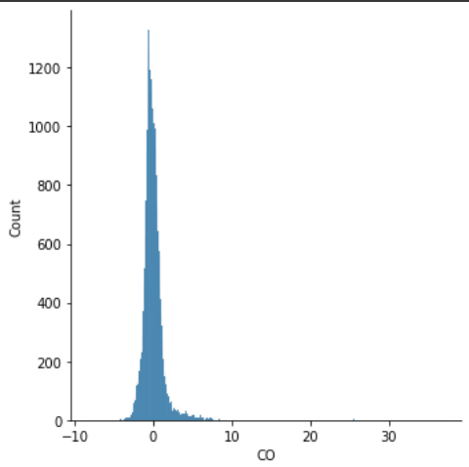
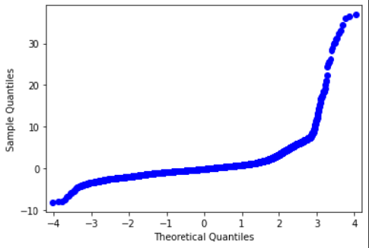
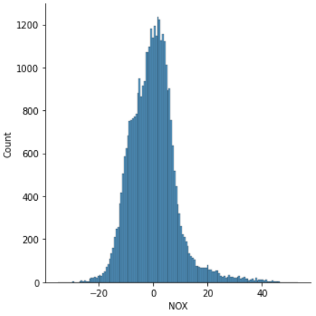
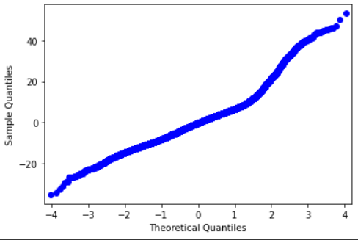
Distribution of errors:
CO
NOx
Lasso reg score -
0.5375
Lasso reg score - 0.4634

Slide 10
Analysis and results
Durbin-Watson statistic indicates that there is autocorrelation in residuals of both regressions.
Prediction of NOx has higher error in prediction compared to CO and the errors are normally distributed, indicating that there is information that is not being captured.
Variance inflation factor is very high for all variables except Ambient Temperature and Ambient Humidity.
There is high multicollinearity in the data even among the significant variables.
Values for CO
RMSE Value, CO - 1.945
R-squared, Adjusted R-squared – 0.582
Lasso regression score, CO - 0.5375
Values for NOx
RMSE Value - 64.184
R-squared, Adjusted R-squared – 0.518
Lasso regression score, NOx - 0.4634

Slide 11
Interpretation
Lasso regression indicates that air filter difference pressure, gas turbine exhaust pressure and compressor discharge pressure are not important for prediction of emissions.
Ambient Temperature and Ambient Humidity are not good linear predictors for CO emissions but give good results for prediction of NOx.
Some of the variables that improve prediction of emissions have very high values for variance inflation factor, such as turbine inlet temperature and turbine after temperature. However, they still are observed to be significant and give better R-squared, AIC and BIC values compared to models that drop these variables.

Slide 12
Methodology 2: Machine Learning
We applied the following algorithms to the data and documented the results and RMSE values after optimising the parameters using the python library, hyperopt:
Decision Tree
Random Forest
Gradient Boosting Machines
XGBoost (Extreme Gradient Boosting)
Support Vector Machine

Slide 13
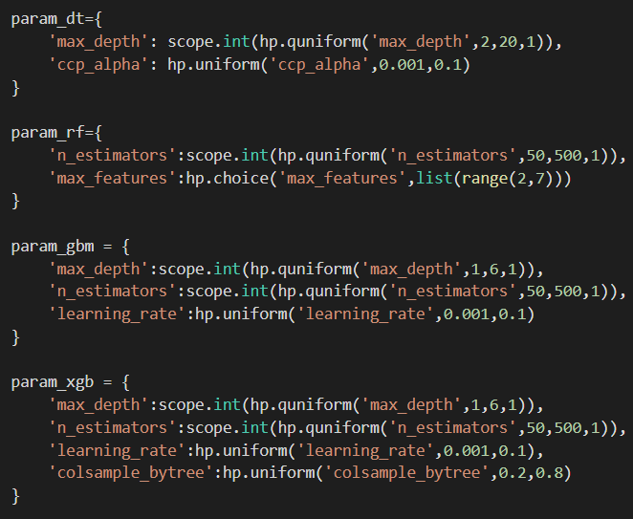
Parameter Search Space and Best Parameters
Decision Tree:
CO: ccp_alpha: 0.024, max_depth: 17.0
NOx: ccp_alpha: 0.024, 'max_depth': 18.0
Random Forest:
CO: 'max_features': 2, 'n_estimators': 229
NOx: 'max_features': 3, 'n_estimators': 317
Gradient Boosting:
NOx: learning_rate: 0.0664, max_depth: 6 n_estimators: 497
CO: learning_rate: 0.0663, max_depth: 5, n_estimators: 254
XgBoost:
CO: colsample_bytree: 0.797, learning_rate: 0.098, max_depth: 5, n_estimators: 380
NOx: colsample_bytree: 0.751, learning_rate: 0.082, max_depth: 6, n_estimators: 420

Slide 14
Analysis and Results:
RMSE Values for CO:-
Random Forest:1.048
XGBoost:1.210
Gradient Boosting: 1.324
SVM: 1.478 (linear)
Decision Tree: 1.725
Linear Regression: 1.945
RMSE Values for NOx:-
Random Forest:16.901
Gradient Boosting: 18.438
XGBoost:18.797
Decision Tree: 31.0495
Linear Regression: 64.184
SVM: 65.546 (linear)

Slide 15
Interpretation:
Random forest performs best for prediction of emission of CO and NOx, giving much better results than all other models
CO prediction shows some degree of success with linear models while the best models are still the non-linear ones
NOx prediction shows the best results for non-linear models and the worst with linear models.

Slide 16
CONCLUSION
There are strong non-linear relationships between emissions of CO and NOx and the predictor variables, which were best predicted using a random forest model.
Ambient Temperature and Ambient Humidity are seen to be negatively correlated to emissions.
Air filter difference pressure was seen to be negatively correlated to CO but positively correlated to NOx.
Ambient Pressure is insignificant even at 90% confidence level for CO prediction and gas turbine exhaust pressure is insignificant at 95% confidence level but significant at 90% confidence level.
CO and NOx have been seen to steadily increase from 2011 to 2015, therefore measures need to be taken to mitigate this.

Slide 17
THANK YOU!

